Slide 1

Centralize Settings Management via Azure App Configuration
Notes:
Currently in preview- GA by the end of 2019
Free!!! (for now)

Slide 2
Samara Soucy @oneangrypenguin samara.soucy@microsoft.com
Software Engineer -- Microsoft
Azure Customer Experience -- Community Engineering

Slide 3
Once upon a time
In a project far, far away...

Slide 4
Happy Monday team!
We need to change the theme colors on all of our web apps. Hope that isn't too much trouble!
Notes:
If you’ve been in software dev for awhile, you’ve probably had this kind of conversation.

Slide 5
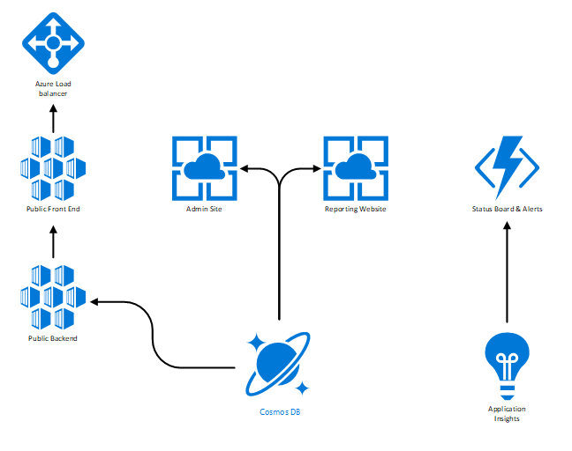
Just one problem:
That means changing several sites...
Notes:
Old way: monolithic systems
New way: distributed (microservices, containers, Docker, Kubernetes)
Lots of config files, lots of code bases, lots of deployments to make a change

Slide 6
The Solution: Centralized Configuration Management
Single location for settings that all apps in a system can pull data
Fewer configuration files edited with each settings change means fewer opportunities for errors
Caching allows for changes in production without restarting the servers
Admins can easily view the history of settings changes separate from the code base
Easily backup values or sync between stores
Useful for traditional App.config settings, but also CSS, text, or features that you might want to change
Azure App Configuration, AWS Parameter Store
Notes:
What is configuration management?
Why configuration management?
Show setup in Azure and import

Slide 7
Settings
Two different ways to organize settings
Hierarchy: mainApp:theme:AccentColor, mainApp:theme:BackgroundColor
Use hierarchy to group settings for a specific app.
GET /kv?key=mainApp*
Use labels to group different values for the same key.
Labels: <dev> <prod>
GET /kv?key=mainApp*&label=prod
Can also request a value from a specific date or etag
Notes:
Two big concepts: first is settings.
SDK for .NET and Java Spring for initial config
For everything else you can use CLI or REST API
Hierarchy (internal) or labels (deployment)

Slide 8
Dynamic Updates
Simplest method of doing dynamic updates is to cache values.
.Net Core has 30 second default
Configure which values will update (deployment settings don’t need to update) and how often
Setup Event Grid subscriptions to react immediately
Update applications in real time (or close to it)
Log or take additional actions when a value is changed or deleted
Notes:
Push vs. Pull (Service Bus & Event Hub)

Slide 9
Security Considerations
Data is encrypted at rest and in transit- keys are not encrypted
Access is not segmented- if an app has access to the store it can access to all values in the store
Authentication is handled through HMAC-256 or Managed Identity through Azure AD
Use App Configuration to store the locations of secrets in Key Vault to maximize security instead of storing secrets directly in App Configuration
Notes:
Key Vault for secrets, App Config for everything else

Slide 10
Upper management has decided that the new feature you have all been working on needs to go out even though it isn't finished quite yet.
Notes:
Here’s another conversation most of us have had

Slide 11
Feature Flags
Specialized Settings that only allow two values. Enabled: true or false
Enabled features can have filters that you can check when implementing them in your code.
Ex. BetaTester or PremiumUser
Roll out new features incrementally or roll back quickly if there is a critical issue
Segment users with different features without hard coding roles

Slide 12
Resources
Main Docs: https://docs.microsoft.com/en-us/azure/azure-app-configuration/
Product Team Github Repo: https://github.com/Azure/AppConfiguration
Slide Deck: https://oneangrypenguin.com/presentations
Presentation Code: https://github.com/serri588/AppConfigDemo

Slide 13

Platinum Sponsors

Slide 14





Gold Sponsors

Slide 15

Special Thanks

